Slide 1

Presentation M5 - ScholarLog
26.06.11 - Hofer Lukas - TINF2
Notes:
Date : format international standard ISO 8601

Slide 2
Content
01
Problematics
04
Demonstration
02
Needs
05
Conclusion
03
My solution
06
Questions
Duration of presentation: 15 min (5 min questions)

Slide 3
Problematics
01
x
Average rating
What is my current average ?
How do I calculate my average ?
Did I calculate correctly ?
Results
Where should I record my results ?
Where did I put my proof ?
Work logs
Where should I keep my work journal ?
How much time did I spend on that task ?

Slide 4
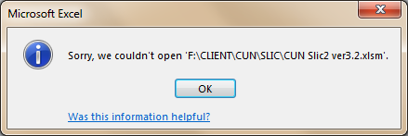
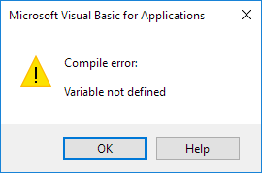

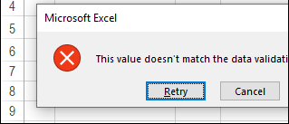
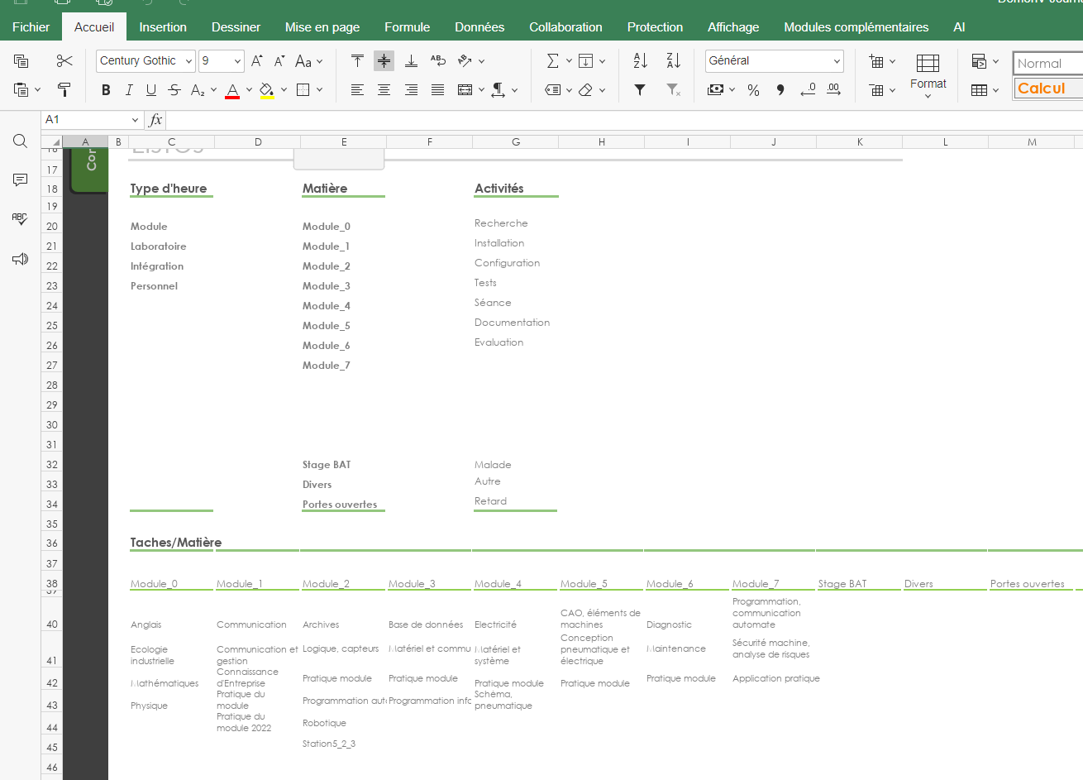
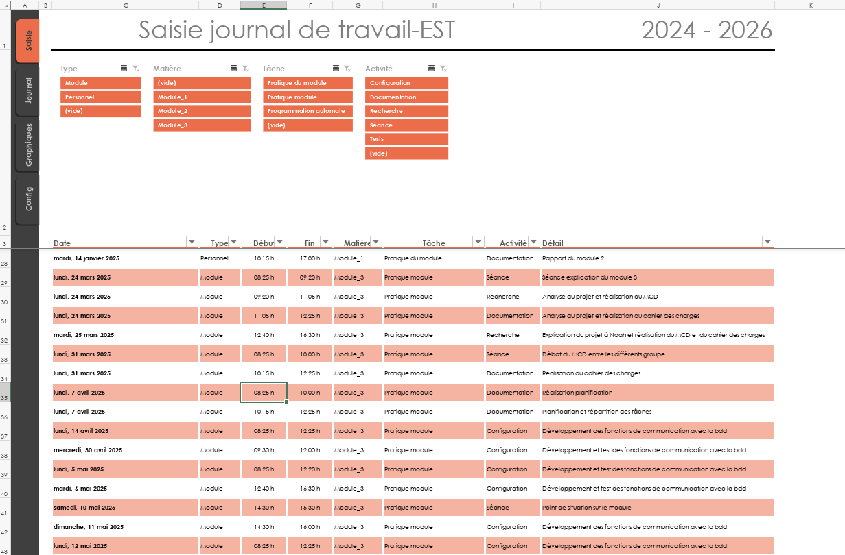
Problematic
01
Solutions ? (Excel)
Technical instability :
Too much macros
Heavy ergonomics :
UI is not user friendly
Archiving not possible :
Not possible to put PDF

Slide 5



Problematic
01
Solutions ? (Cloud app)
Confidentiality :
You don’t really own your own data
Internet only :
No access to your results or scans when offline
time consuming :
You build your own databases from scratch

Slide 6
Needs
02
What a student really need ?
Automatic Math
Instant, error-free weighted averages.
Stop wasting time calculating grades manually.
All-in-One Hub
Grades, PDF scans, and work journals unified in a single, perfectly organized place.
PDF Support
Link optimized PDF scans directly to the grades and study anywhere without heavy binders.
100% Privacy
Zero cloud dependency.
Your academic data stays completely safe on your local machine.

Slide 7
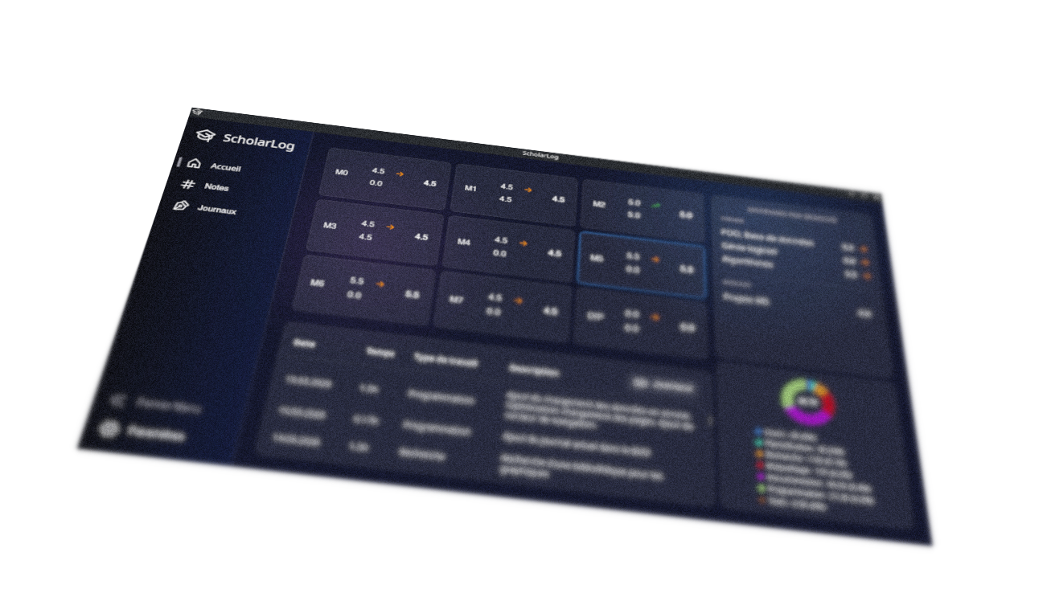
My solution
03
The ScholarLog Application
A Tailor-Made Tool
ScholarLog is an offline, all-in-one desktop application built
specifically for EST students.

Slide 8
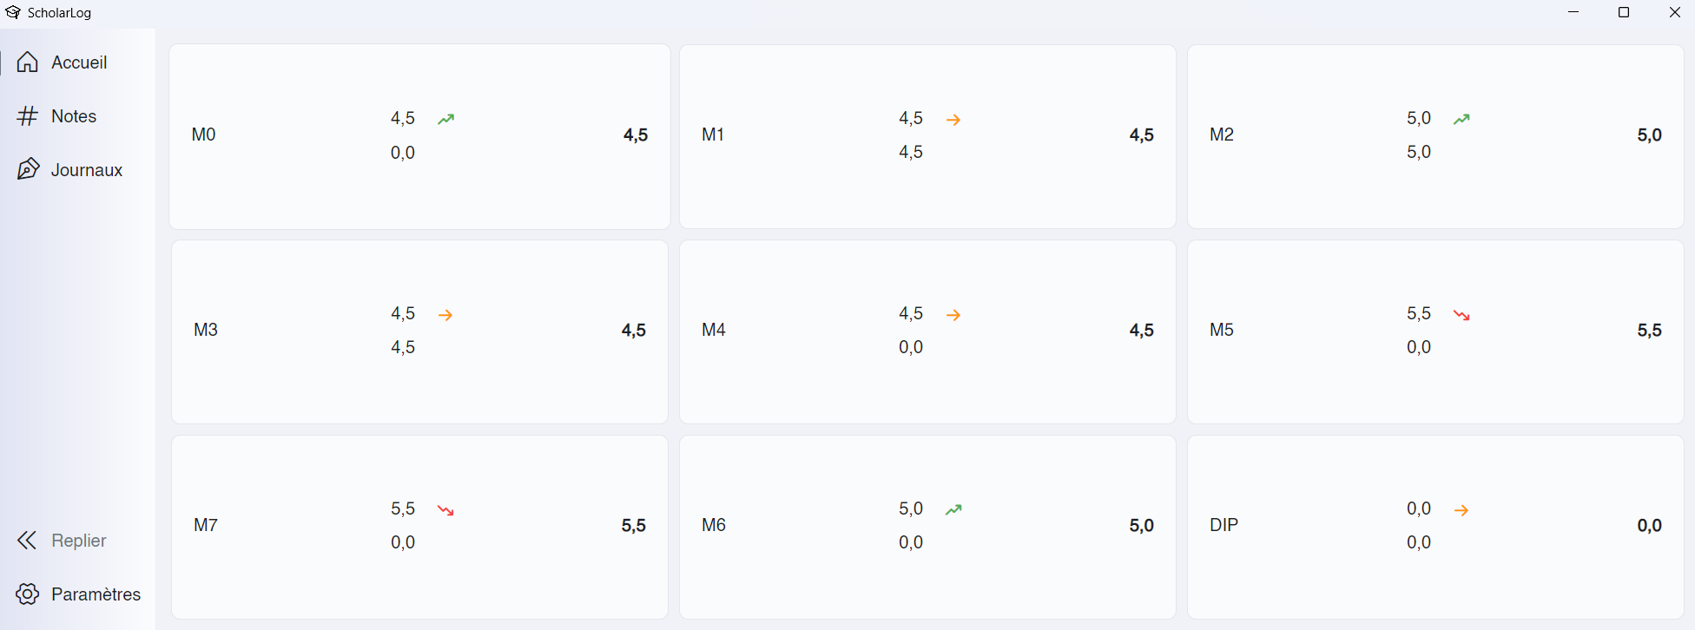
Demonstration
04
Link to the installation files : https://github.com/Hoferlukaslh/ScholarLog/releases/tag/v1.0

Slide 9
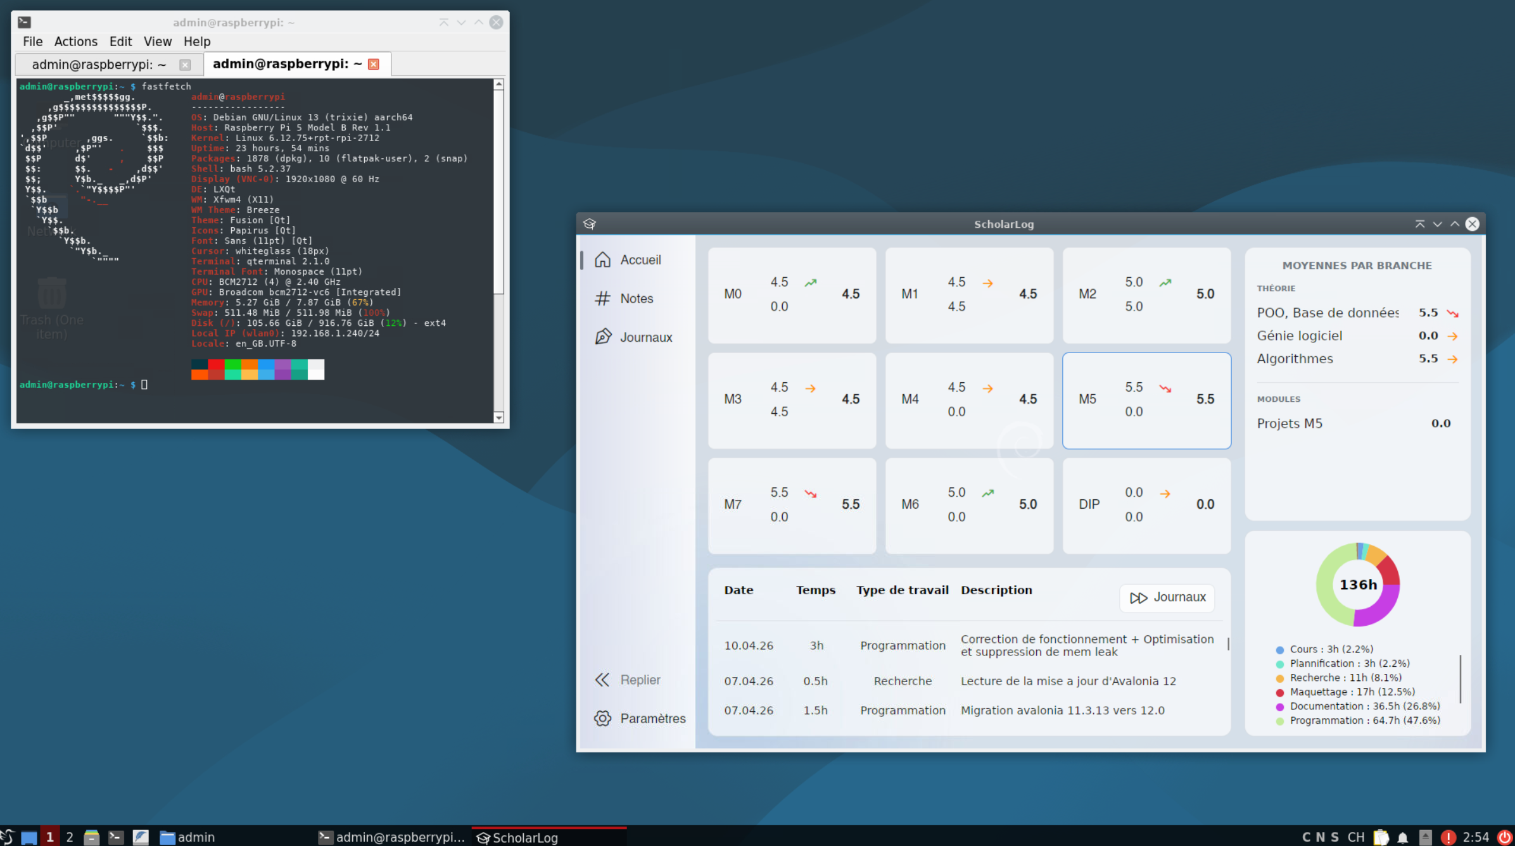
Conclusion
05
Why ScholarLog ?
Time saved
Eliminates manual calculations and chaotic excel sheets,
saving hours of administrative work every module.
GPLv3 Open Source
A collaborative, transparent tool.
Free forever, guaranteeing that the code can evolve with future student needs.
Cross-Platform
Fully automated deployment scripts provide native, optimized installers for Windows, macOS, and Linux.

Slide 10
Questions ?
07

Slide 11
Thanks for your attention !

